Slide 1
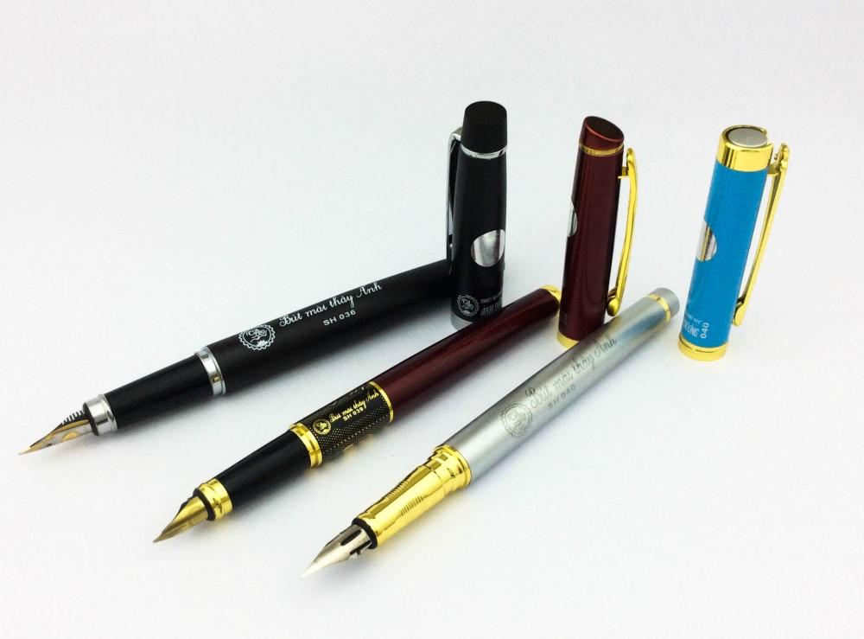
Unit 8.This is my pen .Lesson 2.
Teacher:Lê Thu Lan

Slide 2
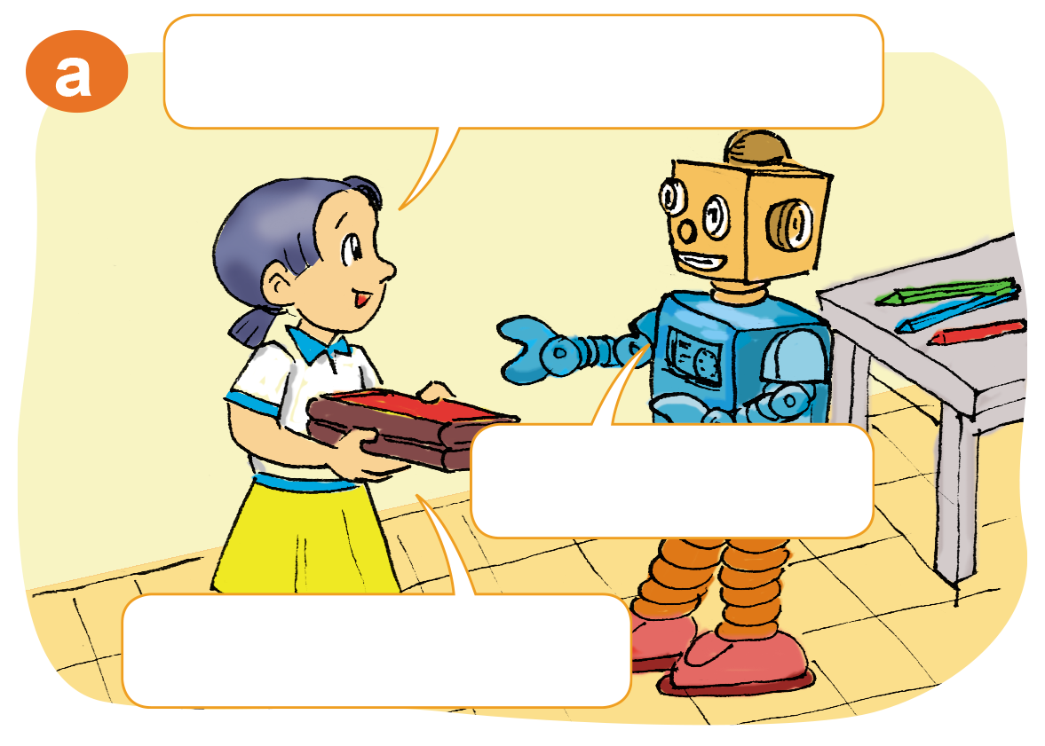
These are my books.
Are they?
Yes,they are.

Slide 3
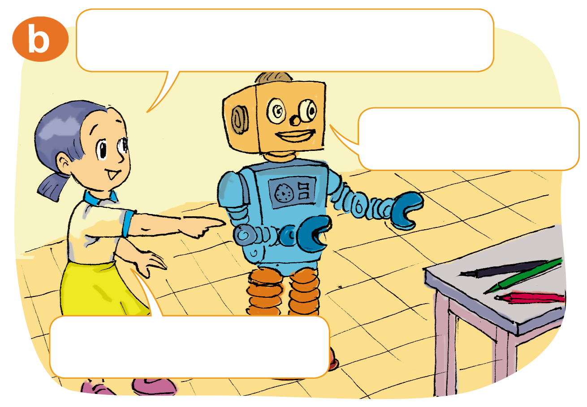
Those are my pencils.
Are they?
Yes,they are.

Slide 4
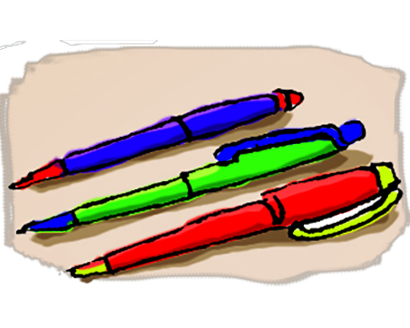
a
b

Slide 5
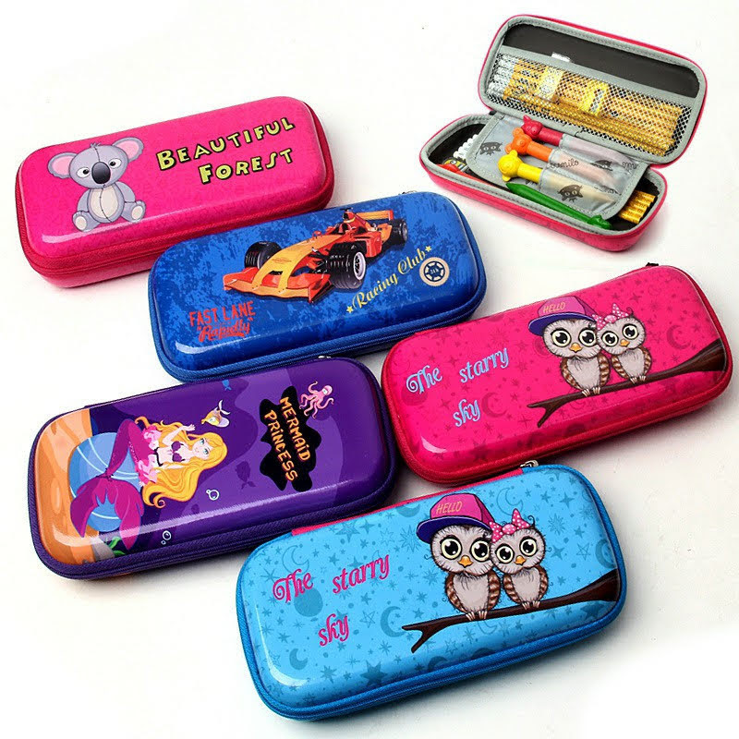
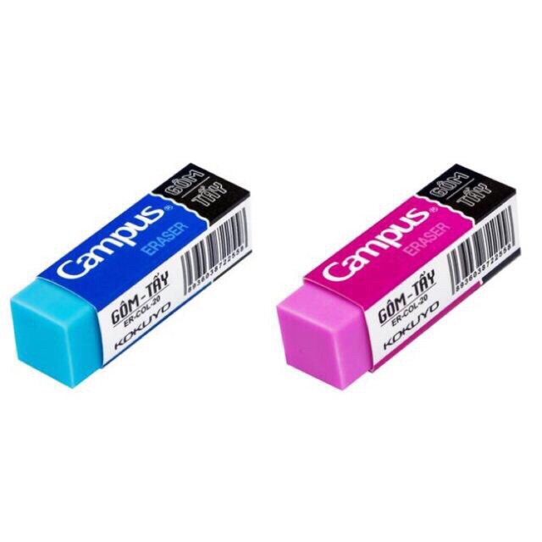
c
d

Slide 6
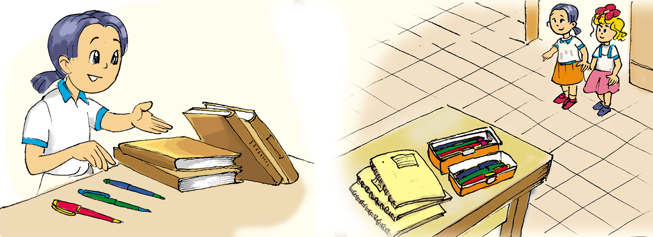

Slide 7
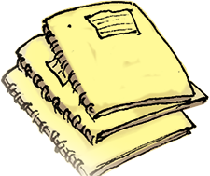
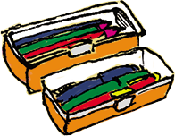
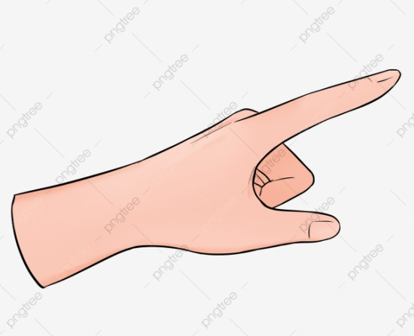
Those...
These ...

Slide 8
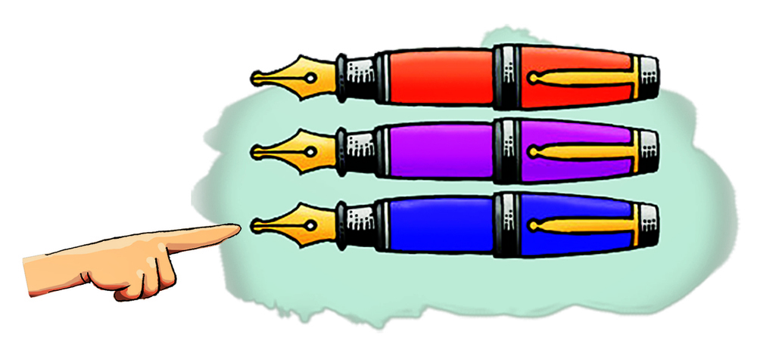
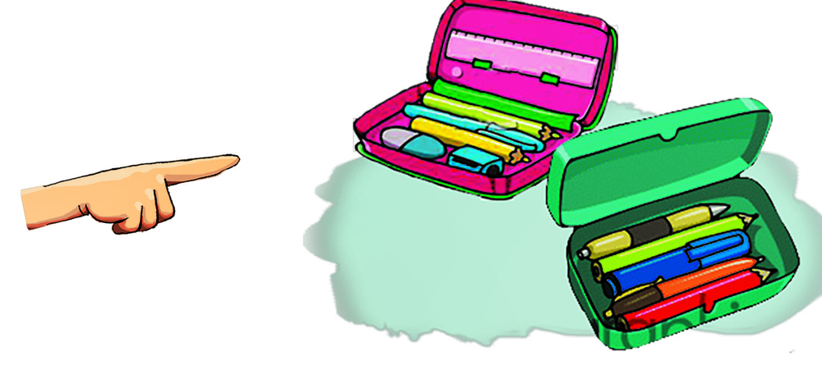
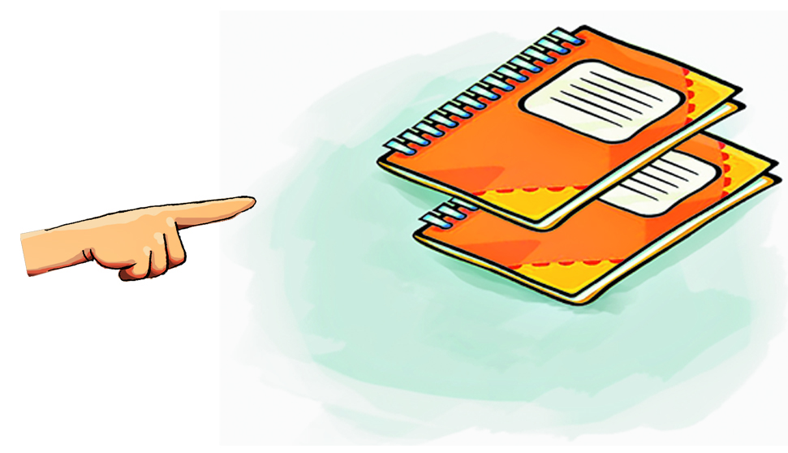
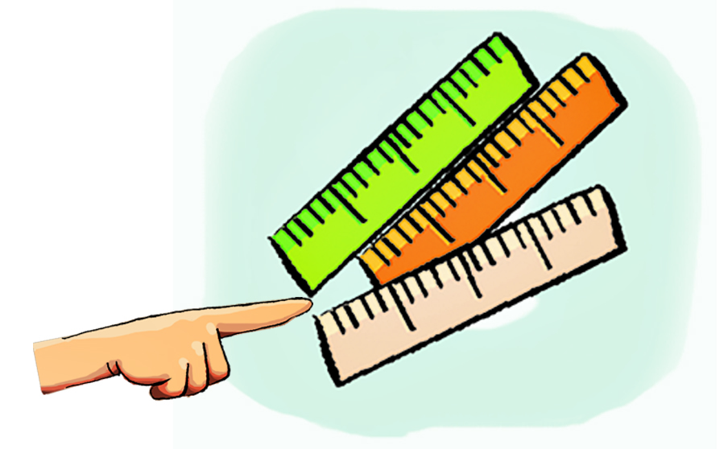
a
b
c
d

Slide 9
3a
4b
2c
1d

Slide 10
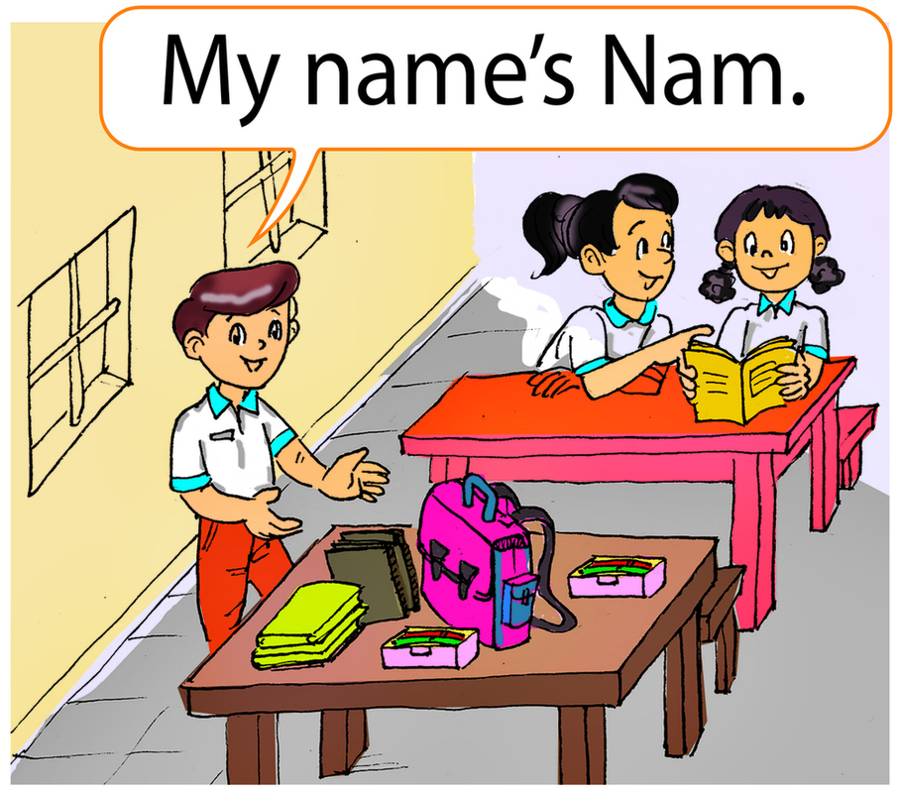

Slide 11
1.My ___ is Nam.
name
2.My classroom is ____
but ___ .
small
nice
3.My ___ is big.
school bag

Slide 12
4.My ___ and ___ are new.
books
notebooks
5.My _______ and ___ are new too.
pencil cases
pens

Slide 13
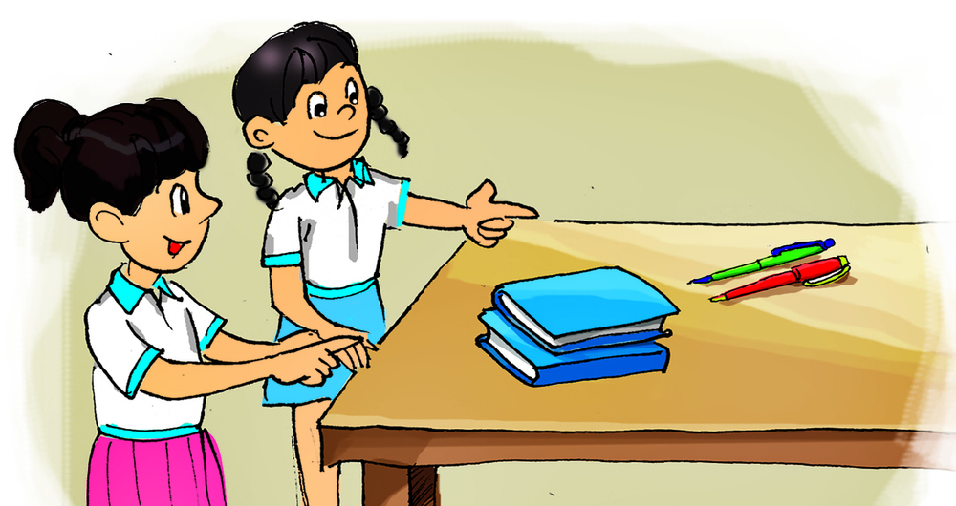
are
notebooks
1.These __ my ___ and ____ .
pens

Slide 14
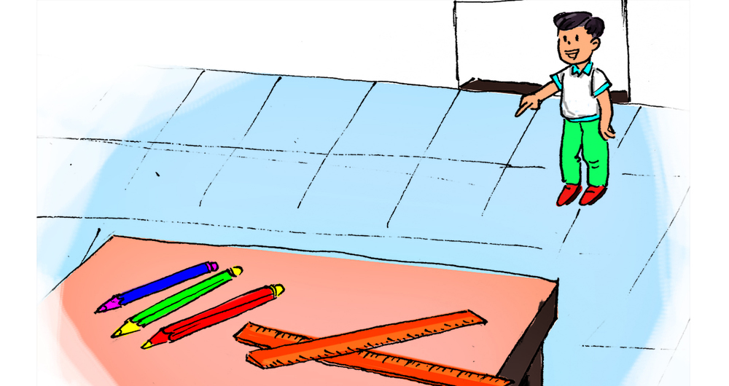
are
pencils
2.Those __ my ___ and ____ .
rulers

Slide 15
Thanks for your attention

